Slide 1


Chapter Four
Labour Supply over the Life Cycle
Prepared by Dr. Mir Ahasan Kabir
York University

Slide 2
Learning Objectives
Explain why it is misleading to compare behaviours and outcomes of different-aged individuals, concluding that the observed differences can be attributed to the pure effects of “age.”
Distinguish between the theoretical effects a temporary increase in wage and a permanent increase in wage might have on an individual’s labour supply decision.
Describe how economists think about household decisions&#160; regarding paid and unpaid work, and whether to become parents.
Describe Canada’s three-tier public and private pension system.
Explain, using diagrams, how changes to Canada’s public pension program can affect the age at which individuals choose to retire, and how this can affect retirement incomes.
© 2021 MCGRAW-HILL EDUCATION LTD.
4 - <number>

Slide 3
Main Questions
Do men’s and women’s labour supply patterns evolve similarly as they age?
Is there a difference in the way individuals respond to wage changes if the possibility that people make labour supply decisions with planning horizons if their entire life is considered?
What complexities are added to the labour supply framework once we try to model labour supply in each period of a lifetime?
How might we incorporate the development of labour-saving household appliances into a model of household labour supply?
How can economic analysis help in our understanding of fertility behaviour and the relationship between fertility and women’s labour supply?
What factors determine the retirement age? What roles do public and private pension plans play in this decision?
© 2021 MCGRAW-HILL EDUCATION LTD.
4 - <number>

Slide 4
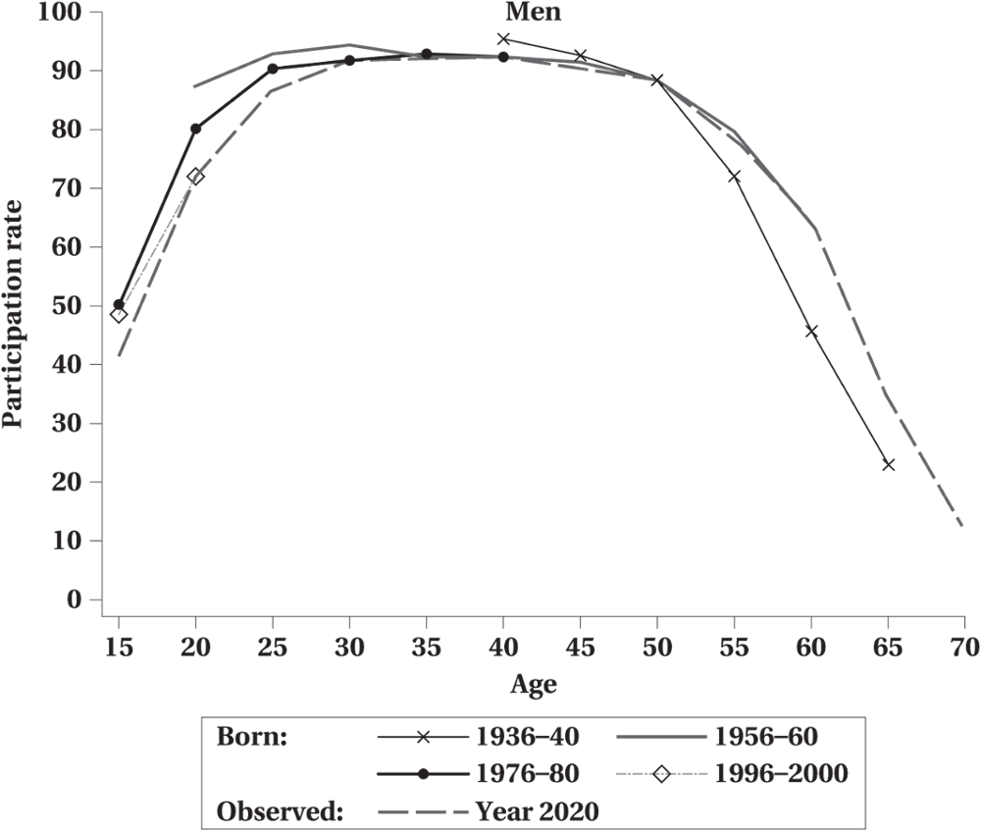
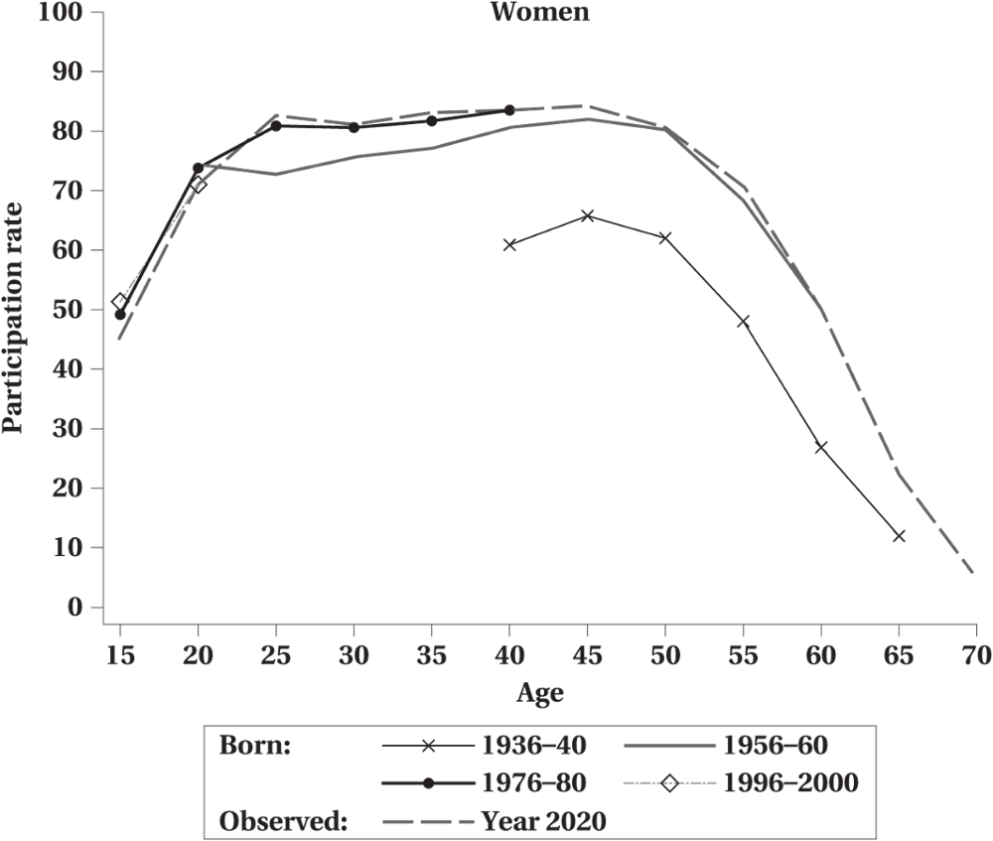
Characterizing Life-Cycle Labour Supply
Figure 4.1 Age–Labour Force Participation Profiles
© 2021 MCGRAW-HILL EDUCATION LTD.
4 - <number>

Slide 5
Characterizing Life-Cycle Labour Supply
Cohort Effect
Refers to the difficulty of separating out age from vintage (or year of birth) at a single point in time.
Best understood in the context of trying to isolate the effect of age, or time, for the evolution of a variable (not necessarily labour supply)
  For women, the age-participation profiles have been shifting upward over time, as each subsequent cohort of women is more attached to the labour market than previous ones.
© 2021 MCGRAW-HILL EDUCATION LTD.
4 - <number>

Slide 6
Characterizing Life-Cycle Labour Supply
WORKED EXAMPLE: What Is a Cohort Effect?
Observed in | 2000 | 2005 | 2010
Older Cohort, born in 1975:
Age | 25 | 30 | 35
Participation Rate | 75% | 80% | 85%
Younger Cohort, born 1980:
Age | 20 | 25 | 30
Participation Rate | 75% | 80% | 85%
Does the current “older generation” provide a good estimate of what the outcomes will be for the “younger generation” when they are older?
© 2021 MCGRAW-HILL EDUCATION LTD.
4 - <number>

Slide 7
Dynamic Life Cycle Model
There are two distinct approaches we could take in devising a theory of life cycle labour supply.
The first approach would treat an individual’s life cycle labour supply as a sequence of static labour supply problems. While this approach is satisfactory for several problems, it ignores the possibility that individuals may be forward looking.
For these reasons, economists have devised a theoretically more appealing dynamic framework. The basic idea is that individuals plan out their lifetime labour supply, given their expected lifetime environment.
Thus, the labour supply decision in any one time period is connected to the decisions made in all time periods.
© 2021 MCGRAW-HILL EDUCATION LTD.
4 - <number>

Slide 8
Dynamic Life Cycle Model
Basic Assumptions:
  An individual lives and potentially works for N periods,
  There is no uncertainty regarding the values of economic variables in the future.
  The person is assumed to have preferences, not just regarding “consumption” and “leisure” today, but over consumption and leisure in each of their N periods of life.
  The individual maximize utility function, choosing their optimal consumption and leisure in each period, subject to their expected lifetime budget constraint.
  For simplicity, assume that there is no nonlabour income.
© 2021 MCGRAW-HILL EDUCATION LTD.
4 - <number>

Slide 9
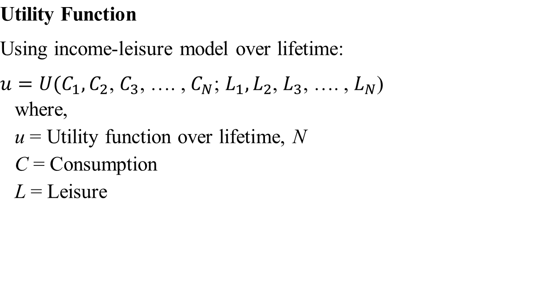
Dynamic Life Cycle Model
© 2021 MCGRAW-HILL EDUCATION LTD.
4 - <number>

Slide 10

Dynamic Life Cycle Model
  Income Constraint
  Assume there is only two periods
  Where W is wage earnings and H is lifetime of labour supply
  Assume the interest rate is r, then the present value of the income constraint becomes
  Replace H_{i} with l_{i} (recall H = T-l), then
© 2021 MCGRAW-HILL EDUCATION LTD.
4 - <number>

Slide 11
Dynamic Life Cycle Model
Wage Changes
Substitution and income effects differ depending on
  Permanent or temporary wage change
  Anticipated or unanticipated wage change
Labour supply response will differ depending on the source of the wage increase
© 2021 MCGRAW-HILL EDUCATION LTD.
4 - <number>

Slide 12
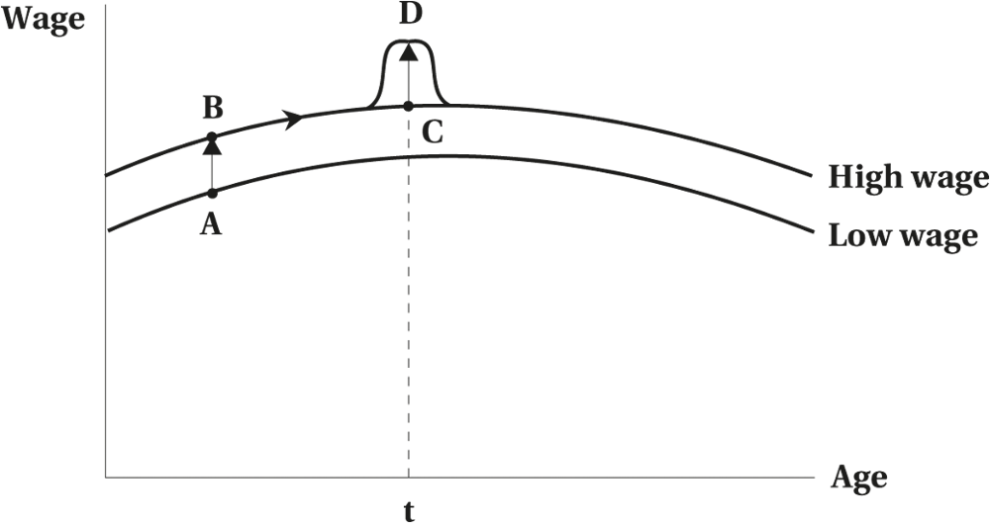
Dynamic Life Cycle Model
Figure 4.2 Dynamic Life Cycle Wage Changes
© 2021 MCGRAW-HILL EDUCATION LTD.
4 - <number>

Slide 13
Household Production
Households as producers as well as consumers
The household’s allocation of its scarce time resources (pure leisure, household work and other activities to facilitate consumption)
Expanding the consumer demand analysis so that the price of a good includes the time costs of obtaining utility from it
© 2021 MCGRAW-HILL EDUCATION LTD.
4 - <number>

Slide 14
Household Production
Basic Framework
Using conventional Utility Maximization Model:
Max. U = f(Z₁, Z₂, Z₃ , …, Z_{n})
Where: Z_{i} = g_{i} (X₁, X₁, …, X₁; h_{i}),
X = market purchased goods,
h = time spent producing Z with X
“Leisure” is not a purely separate good. It is also and input in producing utility from consumption.
© 2021 MCGRAW-HILL EDUCATION LTD.
4 - <number>

Slide 15
Household Production
An Example
For simplicity, assume u = f(nutrition, rest), where nutrition can be attained either through purchasing precooked food or raw food
The consumer thus has to decide how much precooked and raw food to buy, as well as how much time to spend in one of three activities: work outside the home (at wage W), leisure(rest), and food preparation (h).
Three prices may affect household productions:
  Price of Leisure (W)
  Price of a unit of nutrition from raw food (P_{R} +W_{d} )
  Price of a unit of nutrition from precooked food (P_{C} )
© 2021 MCGRAW-HILL EDUCATION LTD.
4 - <number>

Slide 16
Household Production
An Example
Comparative Statics
  A decrease in the price of precooked food, PC
    buy and consume more precooked food, have more leisure time , but the effect on raw food is not clear.
  A decrease in the price of raw food, PR
    buy and consume more raw food, have less leisure time , but the effect on precooked food is not clear.
  An increase in the wage rate, W
    rising wages will tilt demand away from time-intensive goods
  A decrease in preparation time, d
    reduce the relative price of home-cooked food, may increase leisure time or labour supply depending on the income and substitution effects.
© 2021 MCGRAW-HILL EDUCATION LTD.
4 - <number>

Slide 17
Fertility and Childbearing
Important in understanding women’s labour supply
Variables affecting fertility decision
  Income
  Cost of Child
  Price of Related Goods
  Tastes and Preferences
  Technology Advances
© 2021 MCGRAW-HILL EDUCATION LTD.
4 - <number>

Slide 18
Fertility and Childbearing
Income
  Positive relationship between income and the desired number of children
  Contraceptive knowledge and the cost of having children tend to be related to the income variable
  Difficult to separate the pure effect of income on decision
© 2021 MCGRAW-HILL EDUCATION LTD.
4 - <number>

Slide 19
Fertility and Childbearing
Price and Cost of Children
  The demand for children is negatively related to the price or cost of having children
  The main cost is income foregone by spouse
  Increase in potential earnings can have both an income (positive) and substitution (negative) effect on decision to have children
© 2021 MCGRAW-HILL EDUCATION LTD.
4 - <number>

Slide 20
Fertility and Childbearing
Price of Related Goods
  Dramatic changes in private costs can impact the decision to have children
  A rise in the price of complementary goods (medical, daycare, education, etc.) would reduce desired number of children
  Fall in price (public subsidies) could encourage larger family sizes (e.g., public education, daycare subsidies, free or subsidized health care, family allowance, child tax credits)
© 2021 MCGRAW-HILL EDUCATION LTD.
4 - <number>

Slide 21
Fertility and Childbearing
Tastes and Preferences
  Women’s liberation movements
  Family planning
  Change in values
  Cultural/background/religious effects
  Recently encouraged smaller family size (improvement in quality vs. quantity of having children)
© 2021 MCGRAW-HILL EDUCATION LTD.
4 - <number>

Slide 22
Retirement Decisions and Pensions
An area of increasing concern
Retirement could imply:
  Leaving the labour force
  Reducing hours worked
  Moving to a less difficult job
Impacts social policy
Concerns of solvency of pension funds
© 2021 MCGRAW-HILL EDUCATION LTD.
4 - <number>

Slide 23
Retirement Decisions and Pensions
Effects of Retirement:
  Private savings
  Unemployment
  Size of labour force
  National income implications
© 2021 MCGRAW-HILL EDUCATION LTD.
4 - <number>

Slide 24
Retirement Decisions and Pensions
Theoretical Determinants of Retirement:
  Mandatory retirement age
  Wealth and earnings
  Health and the nature of work and the family
  Public and private pension plans
© 2021 MCGRAW-HILL EDUCATION LTD.
4 - <number>

Slide 25
Retirement Decisions and Pensions
Mandatory Retirement Age:
Compulsory Retirement Provisions: Requires retirement at certain age but allows continuation of service usually on a year-to-year basis.
Automatic Retirement Provisions: Requires retirement, no longer allowed to provide the service.
© 2021 MCGRAW-HILL EDUCATION LTD.
4 - <number>

Slide 26
Retirement Decisions and Pensions
Wealth and Earnings
  Increase in Wealth: Income effect, hence more leisure
  Increase in Earnings: Both income and substitution effects—the effect on leisure/retirement indeterminate
Health and the Nature of Work and the Family
  Poorer Health: Induces early retirement
  Hard Physical Work: Induces early retirement
  Family: Two vs. one income earner effect
© 2021 MCGRAW-HILL EDUCATION LTD.
4 - <number>

Slide 27
Canada’s Public and Private Pension
Old Age Security Pension
Social Insurance: CPP/QPP
Employer-Sponsored Pension Plans
Other Arrangements:
  Private savings, privately arranged pensions, RRSPs
© 2021 MCGRAW-HILL EDUCATION LTD.
4 - <number>

Slide 28
Canada’s Public and Private Pension
Old Age Security Pension
  Financed by general tax revenue
  Demogrant or flat amount paid to all persons over age 65
  May be supplemented by means-tested “Guaranteed Income Supplement,” based on need
© 2021 MCGRAW-HILL EDUCATION LTD.
4 - <number>

Slide 29
Canada’s Public and Private Pension
Social Insurance Pension: CPP/QPP
  Financed by compulsory employee and employer contributions
  Benefits related to contributions based on payroll tax applied to past earnings
  Universal participation
© 2021 MCGRAW-HILL EDUCATION LTD.
4 - <number>

Slide 30
Canada’s Public and Private Pension
Formal Income-Leisure Model Application to Pension
Yp = B + (1 – p – t)W(T - l)
Where:
Y_{p} = Income of a pension receiver
B = Pension
W = Wage rate
T = Time
l = leisure, thus (T - l) = hours of work
P = payroll tax rate
t =implicit tax (clawback)
© 2021 MCGRAW-HILL EDUCATION LTD.
4 - <number>

Slide 31
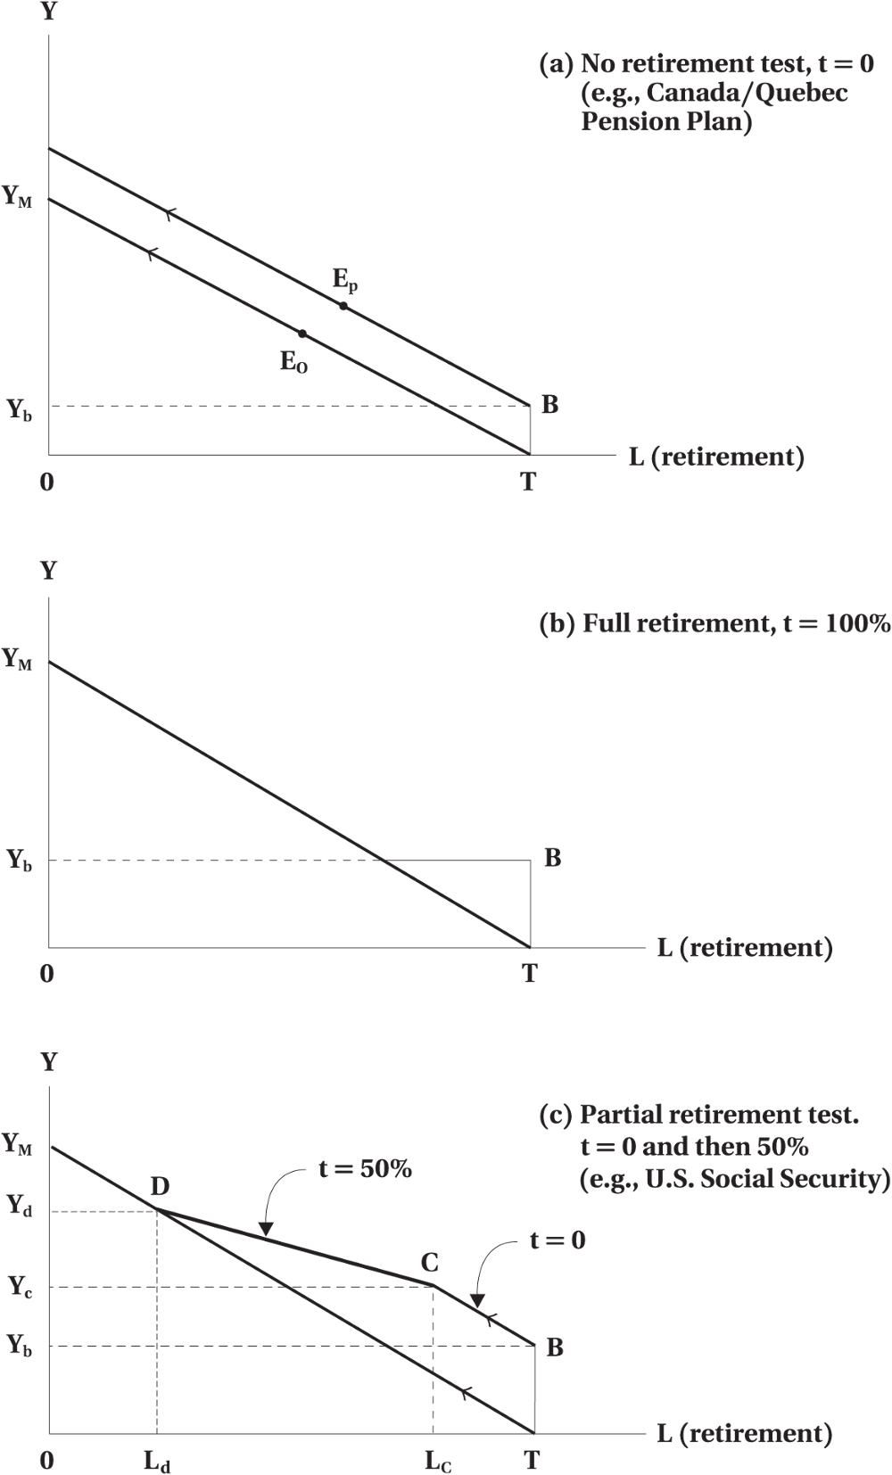
Canada’s Public and Private Pension
Figure 4.3 Budget Constraints under Social Insurance Pensions (assuming payroll tax p = 0)
© 2021 MCGRAW-HILL EDUCATION LTD.
4 - <number>

Slide 32
Canada’s Public and Private Pension
Employer-Sponsored Pension Plans
  Financed by employer, sometimes with employee contributions
  Benefits on type of plan:
    Flat benefit plan
    Earning-based benefit plan
    Defined-contribution plan
© 2021 MCGRAW-HILL EDUCATION LTD.
4 - <number>

Slide 33
Other Provisions of Pension Plans
Backloading
Early/special retirement provisions
Postponed retirement provisions
© 2021 MCGRAW-HILL EDUCATION LTD.
4 - <number>

Slide 34
Other Provisions of Pension Plans
Backloading
  Benefits get larger as seniority-based wage increases
  Young workers have an incentive to stay with the firm
  Older workers have an incentive not to retire too soon
© 2021 MCGRAW-HILL EDUCATION LTD.
4 - <number>

Slide 35
Other Provisions of Pension Plans
Early/special retirement provisions:
  Typically, at age 55 with at least 10 years’ service
  In most earning-based plans
  May be unsubsidized due to reduced number of years of service compared to the normal retirement age
Special Provisions:
  Typically, at age 60–62 with at least 20 years of service.
  Covers about 30% of earning based private pensions.
  Extensively subsidized.
© 2021 MCGRAW-HILL EDUCATION LTD.
4 - <number>

Slide 36
Other Provisions of Pension Plans
Postponed retirement provisions
  Typically involves pension penalties for postponing the retirement past the retirement age.
© 2021 MCGRAW-HILL EDUCATION LTD.
4 - <number>

Slide 37
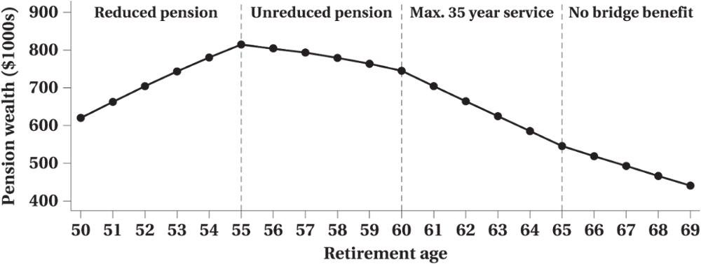
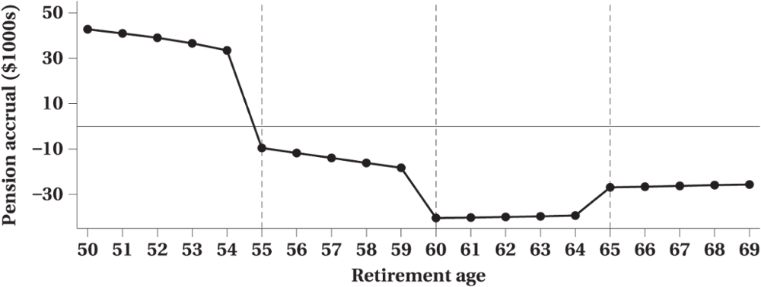
Picking the perfect retirement age
© 2021 MCGRAW-HILL EDUCATION LTD.
4 - <number>

Slide 38
Chapter Summary
Systematic patterns of labour supply as individuals age
Age-labour force participations of men vs. women
Life-cycle model and intertemporal labour supply
    Present value of lifetime income
    Present value of lifetime consumption
Household production and preferences
    Non-market time
Economics of family
Retirement decision and labour supply
© 2021 MCGRAW-HILL EDUCATION LTD.
4 - <number>

